Slide 1


CULS MARKET UPDATE
MICHAEL BRODTMAN
22 NOVEMBER 2018

Slide 2
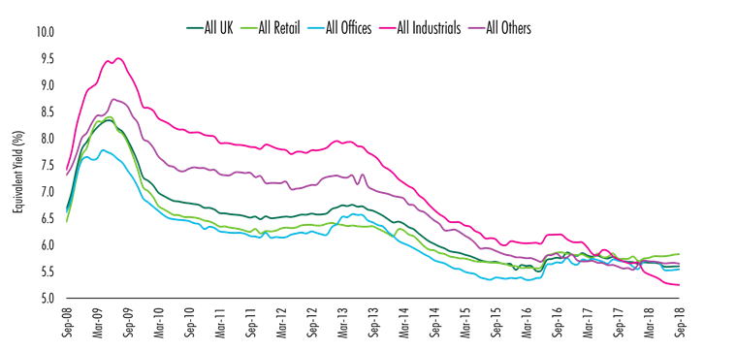
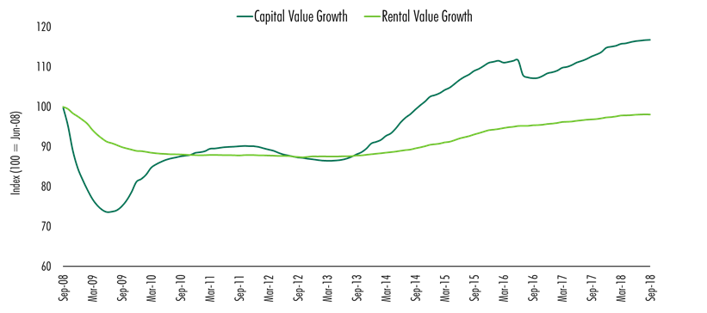
9 years of falling yields and improving values – but now a more challenging landscape…
Equivalent Yields at record lows
Rental Value Growth limited
Source: CBRE UK Monthly Index

Slide 3
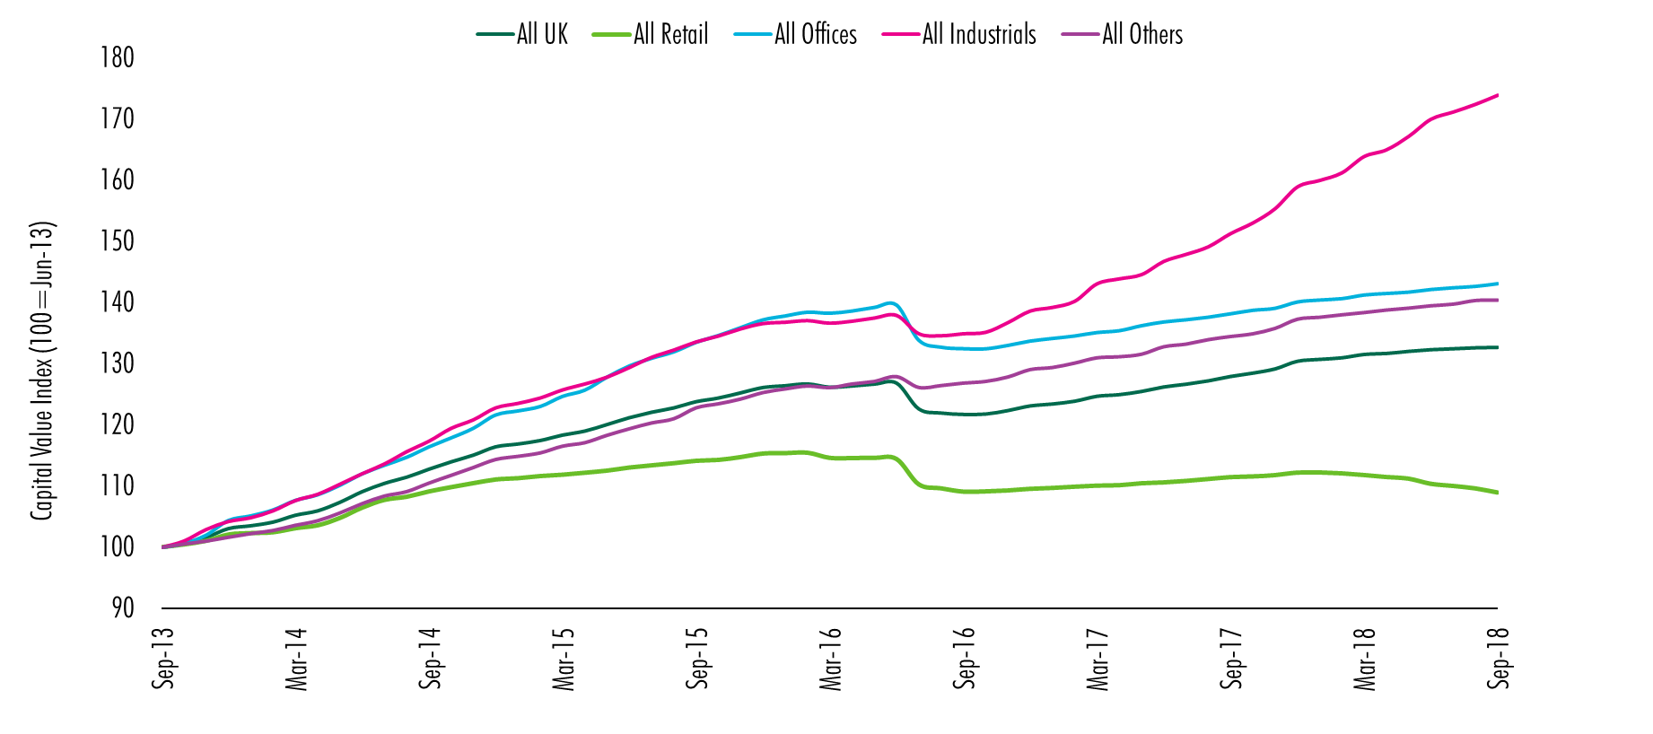
wide range of sector performance as retail suffers, industrials outperform
Source: CBRE UK Monthly Index

Slide 4
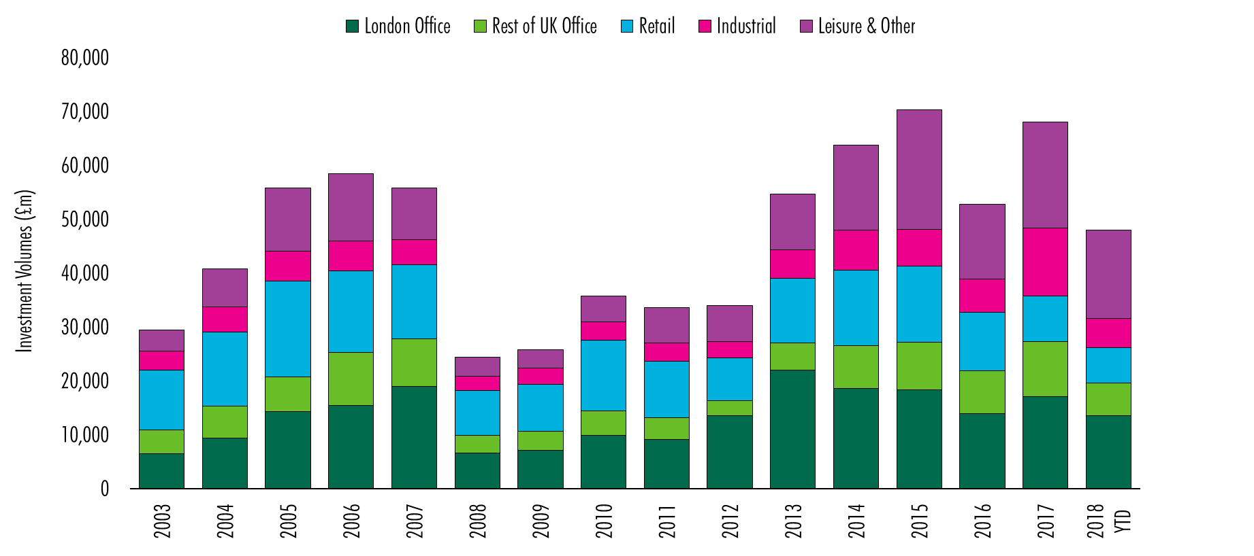
Investment volumes ahead of expectations
Source: CBRE, PropertyData

Slide 5
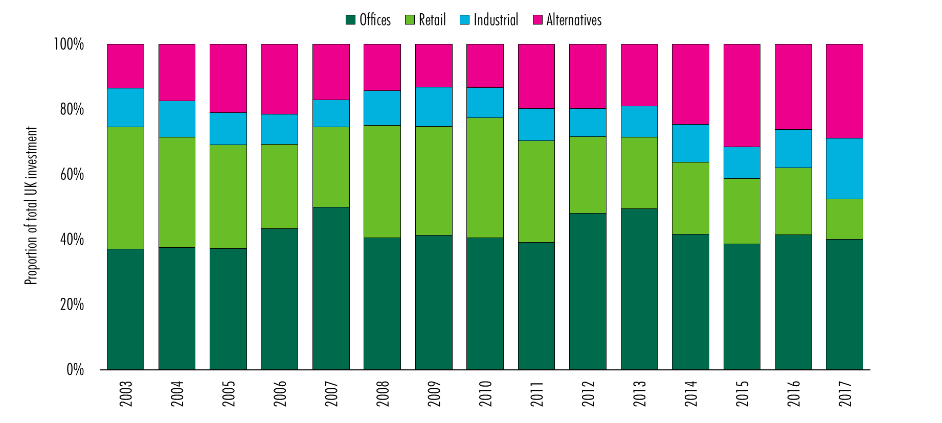
But sector preference is clear as alternatives and industrials overtake retail

Slide 6
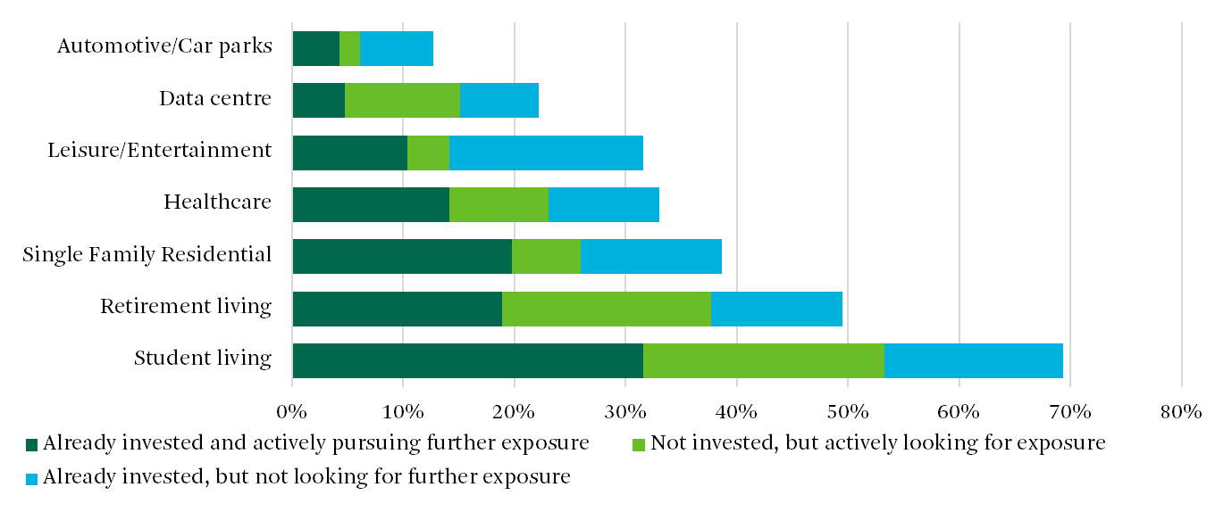
MOST INVESTORS HAVE ALTERNATIVES…AND WANT MORE
Source: CBRE Investor Intentions Survey, March 2018

Slide 7
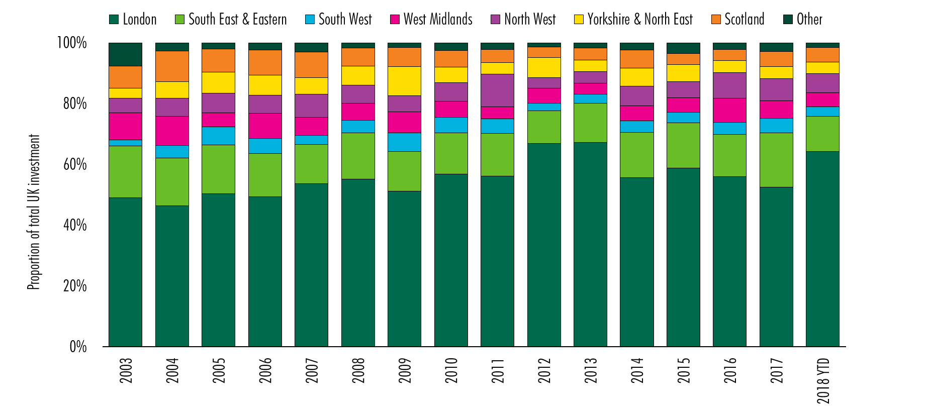
London dominates, attracting over 65%; including 80% foreign investment

Slide 8
Investors navigating new challenges
Political and Economic uncertainties
Rising interest rates put pressure on yields
Powerful structural changes in retail & logistics
Tech, flex and urbanity dominate offices; good demand with increasing costs
Newly investable alternatives sectors growing in scale, but require operational capabilities

Slide 9
THANK YOU

